Slide 1

Rockbuster Stealth LLC
A Movie Rental Company
Analysis project

Slide 2

Project Overview
Rockbuster Stealth LLC Company
As a movie rental company, expanding into the worldwide online renting market is the goal.
Analysis Objective
The management team require answers to business challenges to develop a strategic plan.
Data
The Rockbuster database was utilised for the analysis.
Tools used were Excel, PgAdmin and Tableau.

Slide 3














data Overview
1000 Movies
Replacement Cost
Rental
Duration
Film length
Rental Rate
4.99$
0.99$
2.98$
1000
29.99$
9.99$
19.984$
1000
7
3
4.98
1000
Maximum
Minimum
Average
count
185 MIN
46 MIN
115.7 MIN
1000
109 countries
599 customers
1000 films
600 cities
2 stores
6132.04 $ revenue
Available movie language: english
16044 rentals
Pg13 RATING is the HIGHEST

Slide 4
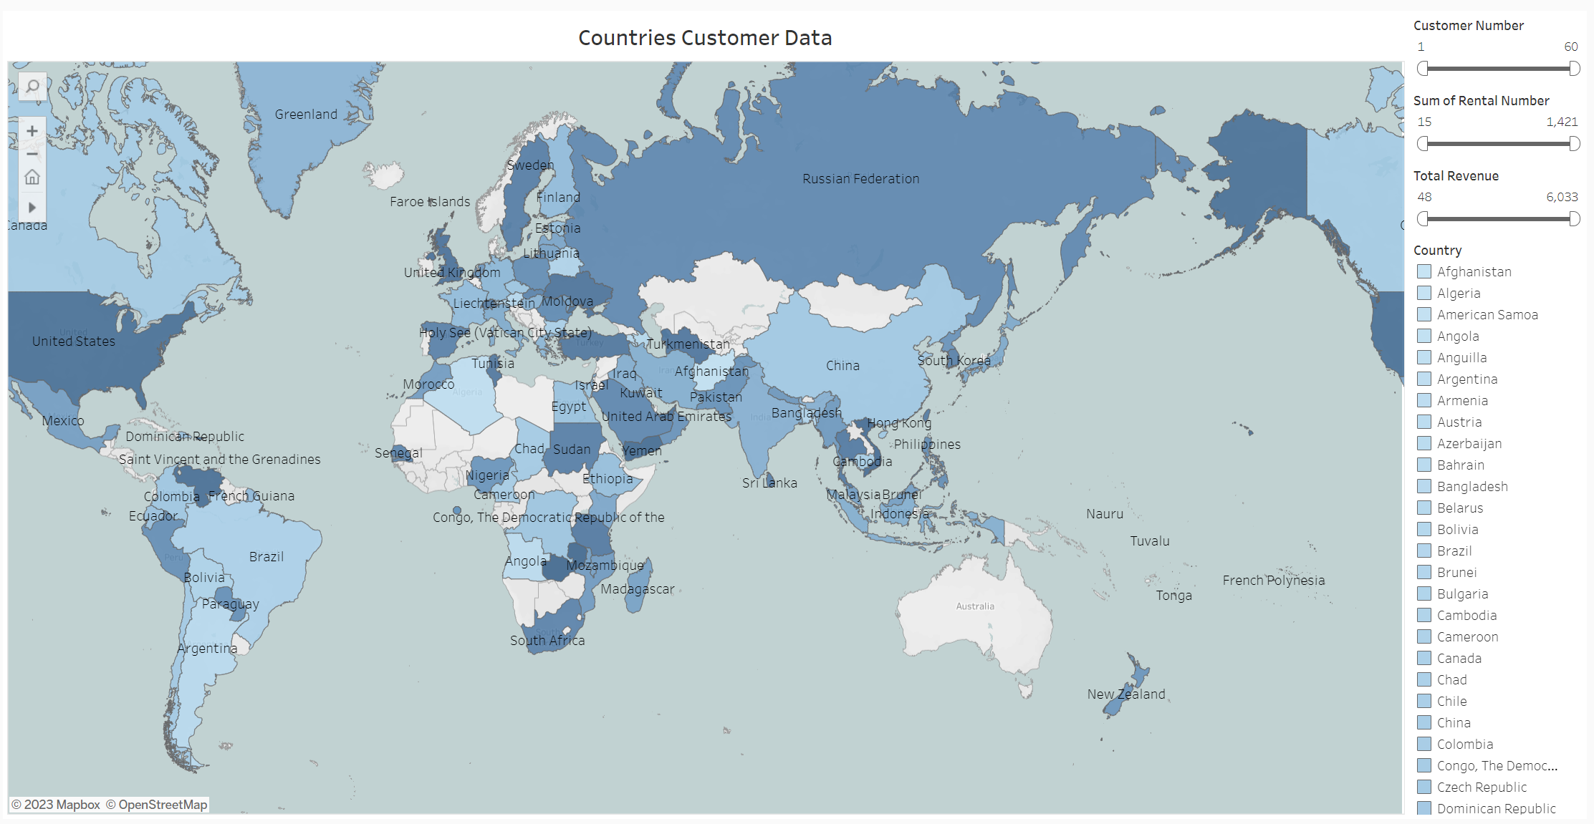
CUSTOMER information
Rockbuster has 599 customers based into 109 countries around the world.
600 cities are found into our database and 2 stores having 2 staff members are helping our clients whenever needed.

Slide 5
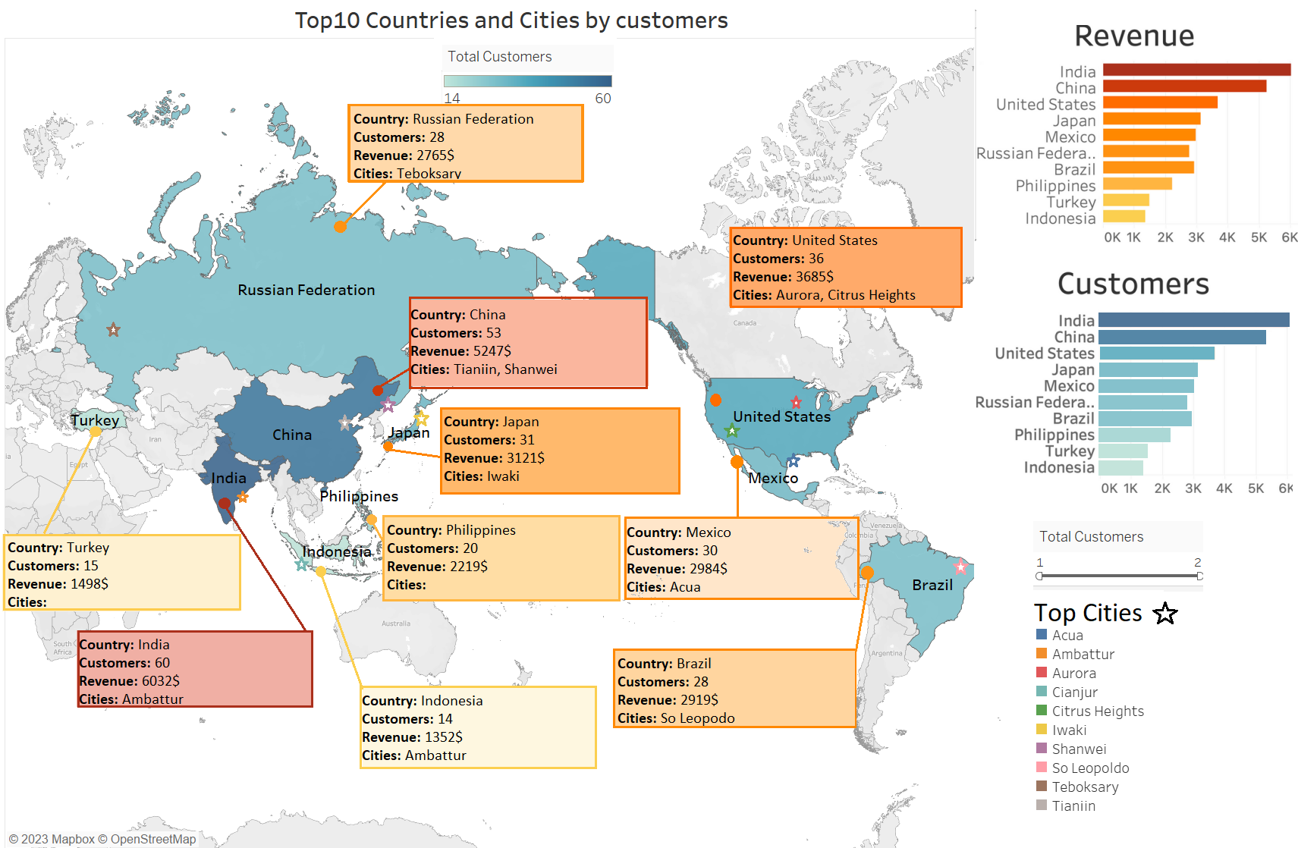
Top 10 Countries by customers and Revenue are: India, China, US, Japan, Mexico, Russia, Brazil, Philippines, Turkey and Indonesia.
These countries provide more than 50% of the total revenue.
India, China and United States are the leaders, making themselves 24% of the global Revenue.

Slide 6
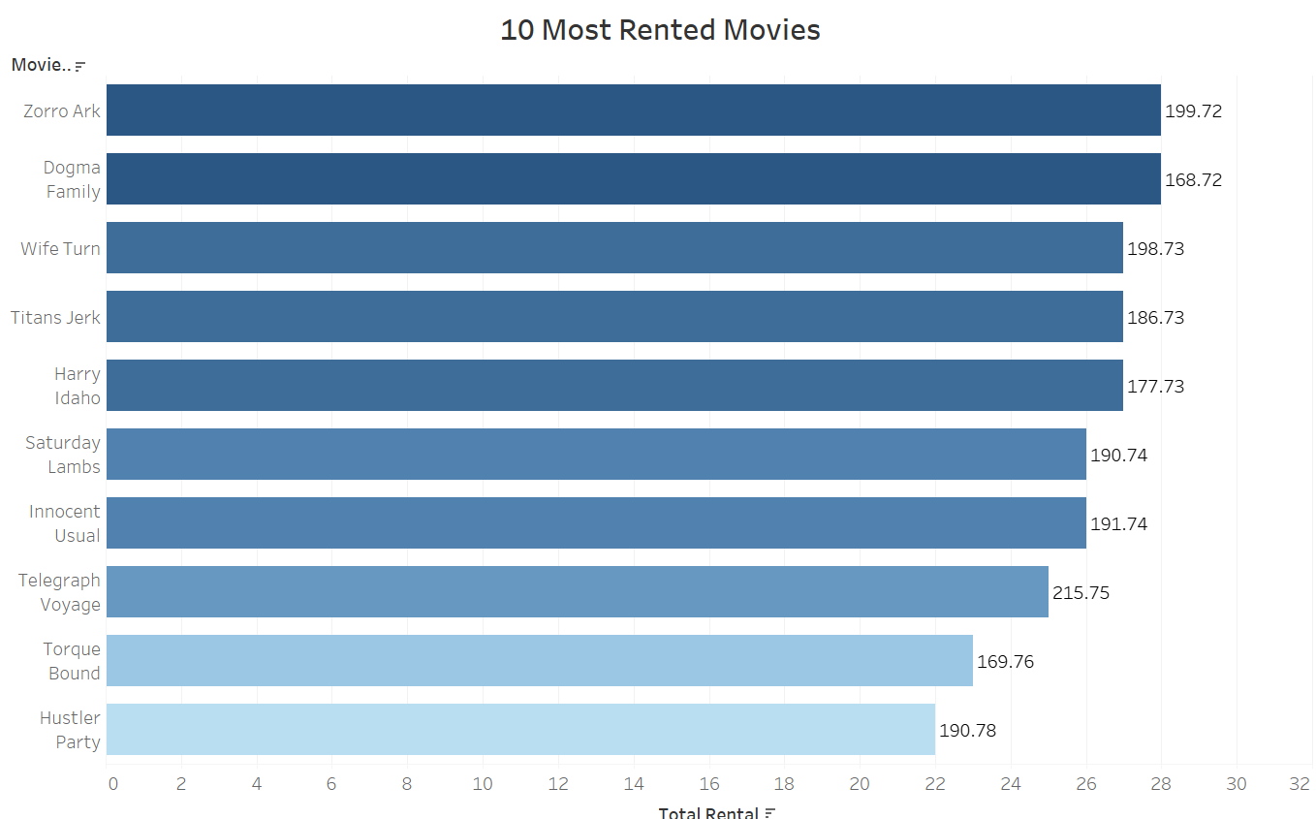
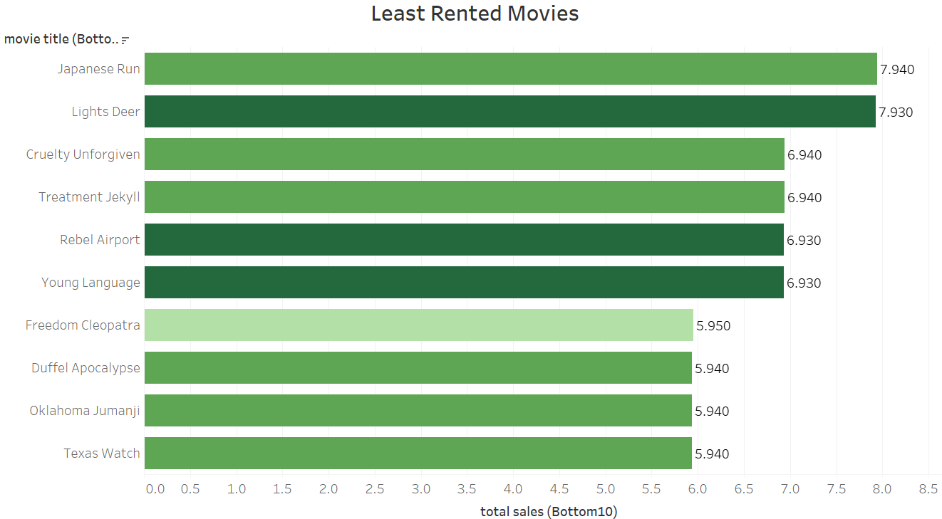
MOVIES ANALYSIS
Zorro Ark is the top rented movie for Rockbuster: 28 times and also with the highest revenue, while Texas Run has the least rental, only 6.

Slide 7
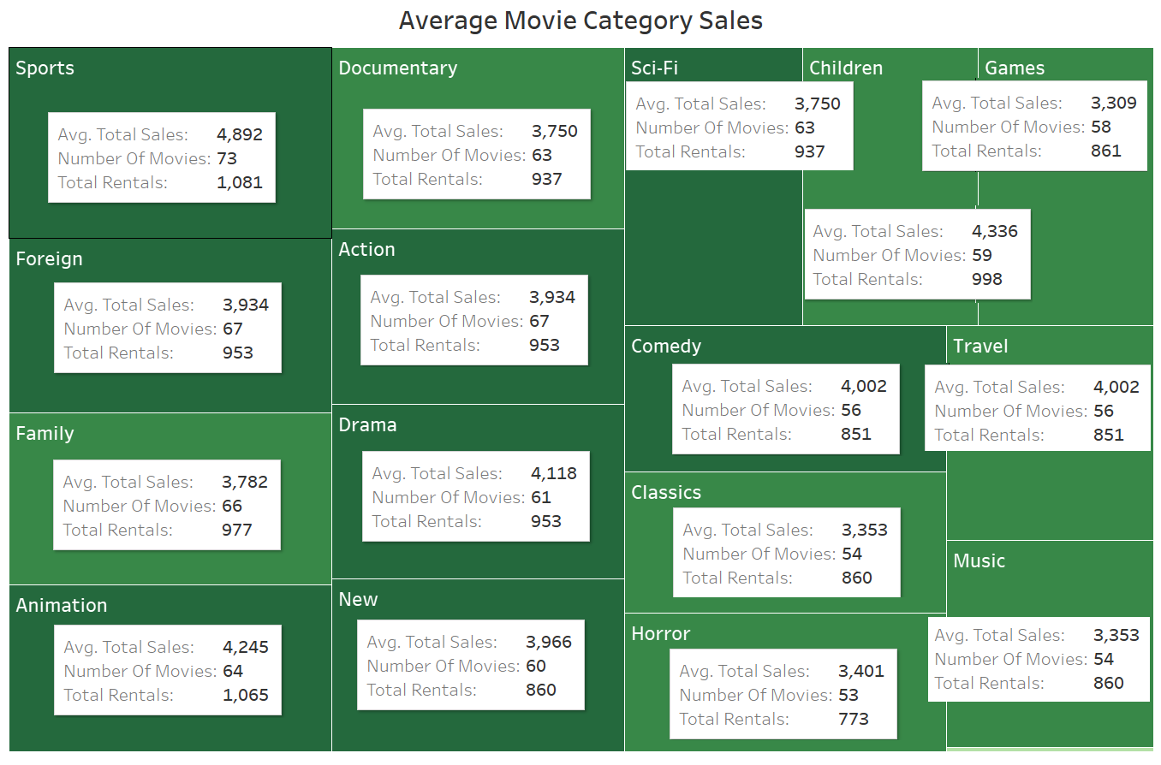
Movie Category
Sports is the most popular category of movie, representing 8% of the rentals with the highest revenue of $4892.
Between $4336 - $3750, we can find Sci-Fi, Animation, Drama, Comedy, New, Action, Foreign, Games, Family, and Documentary, representing 65% of the revenue.
The last categories, below $3401 each, we find Horror, Classics, Children, Travel and Music, representing 27% of the revenue.
As for number of movies, all categories are close to each other.

Slide 8
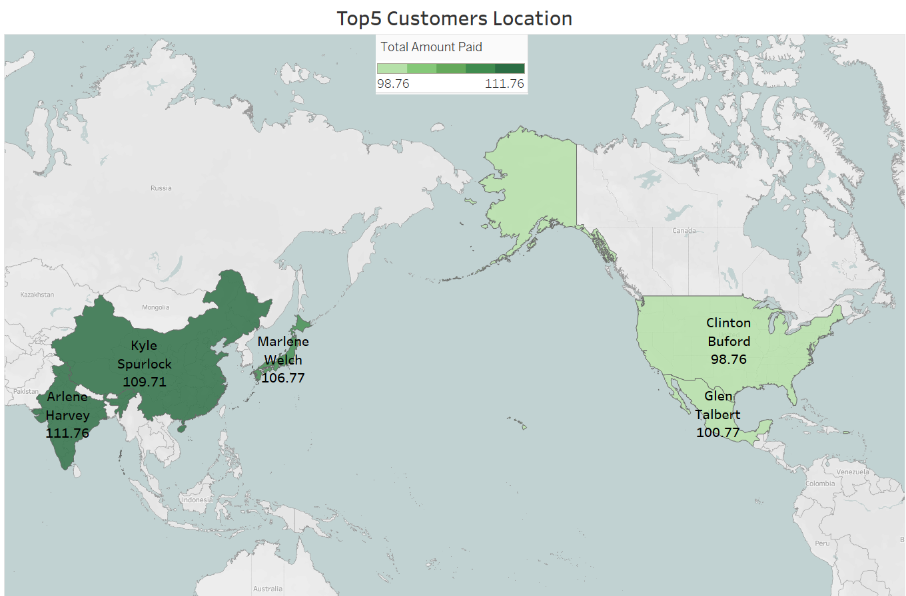
Top 5 CUSTOMERs
Customers that should be rewarded for their loyalty:
Karl Seal - Cape Coral, United States
Marlon Snyder - Santa Barbara D’Oeste, Brazil
Brandon Huey – Balikesir, Turkey
Angela Hernandez – Shimonoseki, Japan
Carrie Porter – Liacheng, China

Slide 9
CONCLUSIONS & RECOMMENDATIONS
CONCUSIONS
recommendations
Since our customers are spread around the world, is perfect for an online service.
The average rental rate is $2.98, with a minimum of $0.99 and a maximum of $4.99.
The average rental duration is 4.985 with a minimum of 3 and a maximum of 7.
The top countries in terms of revenue and customers are China and India, representing 18% of the market, with revenues over $5200 each.
Horror, Classics, Children, Travel and Music are the least popular categories.
PG-13 is the most popular category rating with 3245 rentals and a total of 213 movies, while G is the least rented one: 2508, having available 171 movies.
Our movies are just in English, even if we should have available more languages, this needs to change and extend.
Consider increasing the price for highly rented genre and decreasing it for those with low rentals
Increase number of movies for PG-13 and N-17 since these are best rented and bought genre.
Increase market and national content in the best performing markets, such as India and China.
Investing less in unpopular categories.
Reward system for loyal customers and collect and measure customer satisfaction along the process.
Flexible Subscription Plans for different needs of our customers.
Develop a user-friendly website and mobile app that makes browsing, searching, and renting films a seamless experience.

Slide 10
Thank you!
Tableau Link
Presentation graphics and maps:
Excel
Data collected and all information
Ioana Rusu
Person that made the presentation:

